Slide 1
Discrete Mathematics BCSC0010
Module 1
POSET & LATTICES

Slide 2
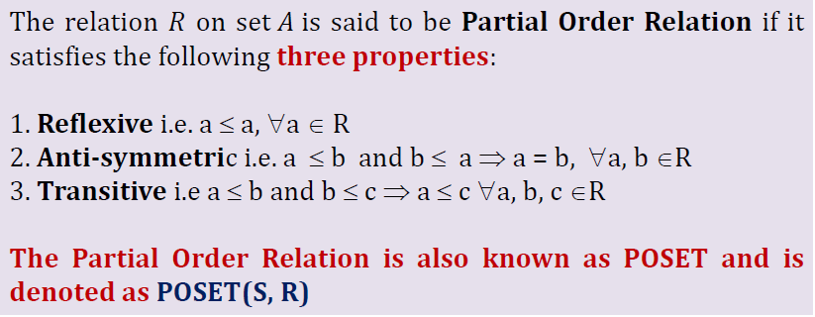
Partial Order Relation
Example : POSET (S, ≤)= ( {1, 2, 3, 4}, ≤)
Here, S is the set = {1, 2, 3, 4}
R is the relation= ≤ (less than equal to)

Slide 3
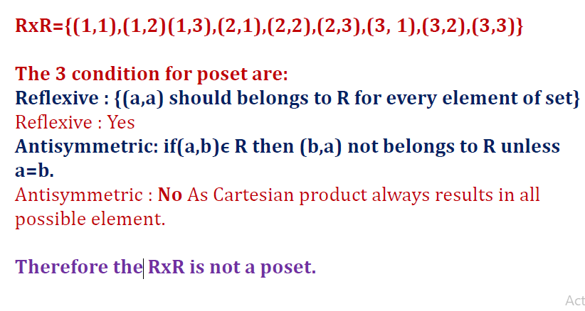
EX
Let R ={1,2,3} identify the relation RxR is poset or not.
R XR= { (1,1), (1, 2), (1, 3), (2, 1), (2, 2), (2, 3), (3, 1), (3, 2), (3,3)}

Slide 4
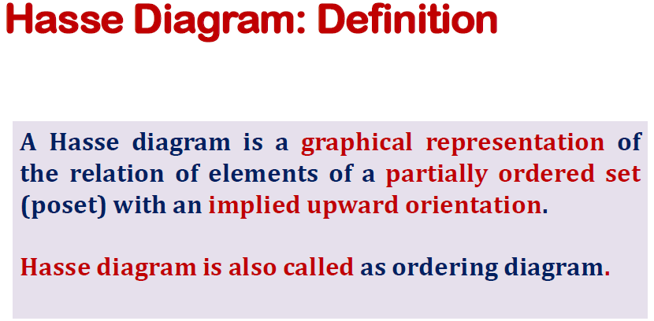

Slide 5
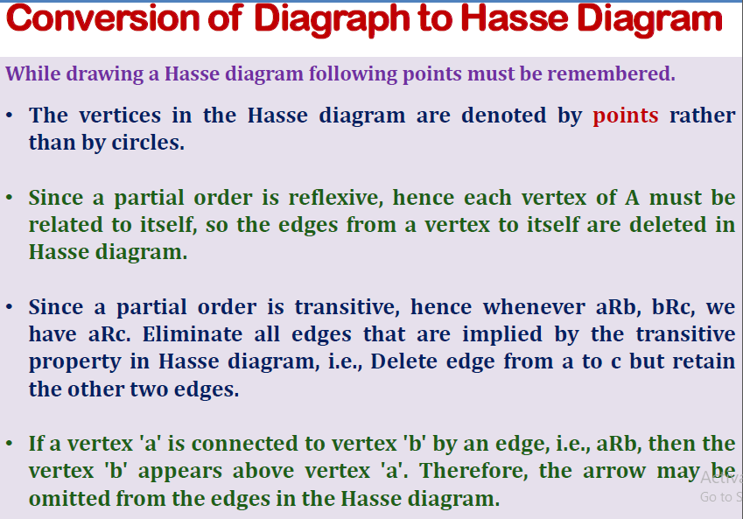

Slide 6
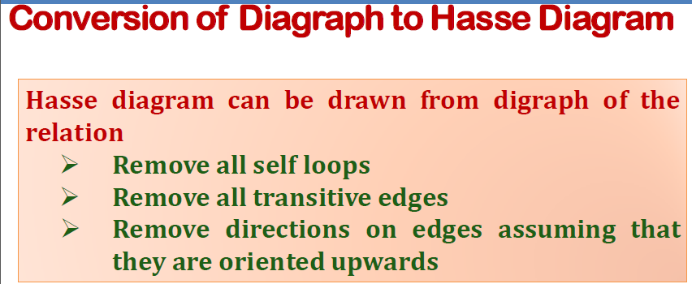

Slide 7
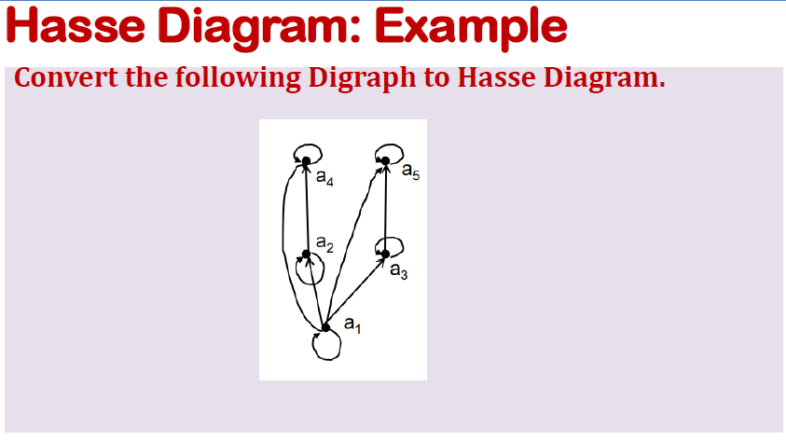

Slide 8
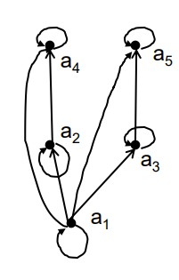
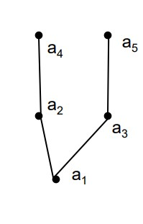
Hasse Diagram: Example
Convert the following Digraph to Hasse Diagram.

Slide 9
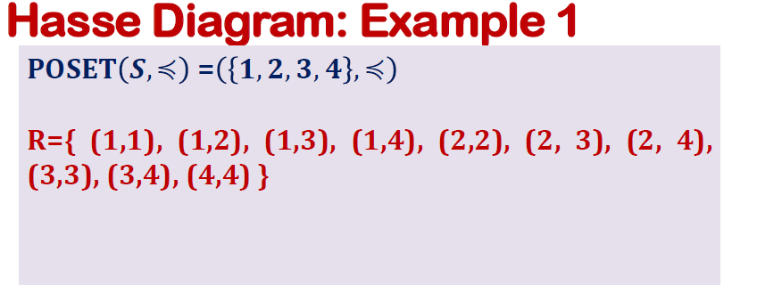
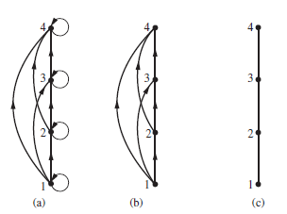

Slide 10
Hasse Diagram: Example 2
POSET 𝑺, | = 𝟏, 𝟐, 𝟑, 𝟒, 𝟔, 𝟖, 𝟏𝟐 , |
R = { (1,1), (1,2), (1,3), (1,4), (1, 6), (1, 8), (1,12),
(2,2), (2, 4) (2, 6), (2, 8), (2, 12), (3, 3), (3, 6), (3, 12),
(4,4), (4, 8) (4, 12), (6,6), (6, 12), (8,8), (12, 12) }

Slide 11
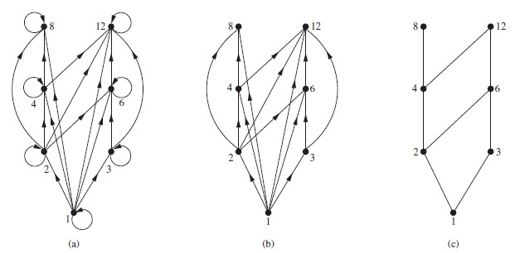
Hasse Diagram: Example 2
POSET 𝑺, | = 𝟏, 𝟐, 𝟑, 𝟒, 𝟔, 𝟖, 𝟏𝟐 , |

Slide 12
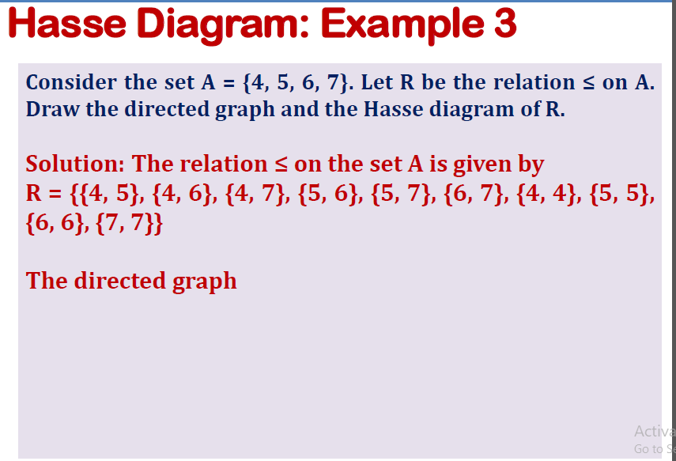

Slide 13
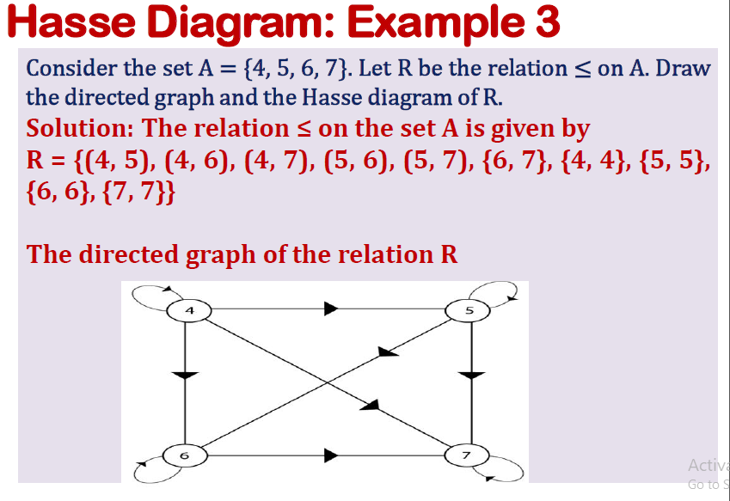

Slide 14
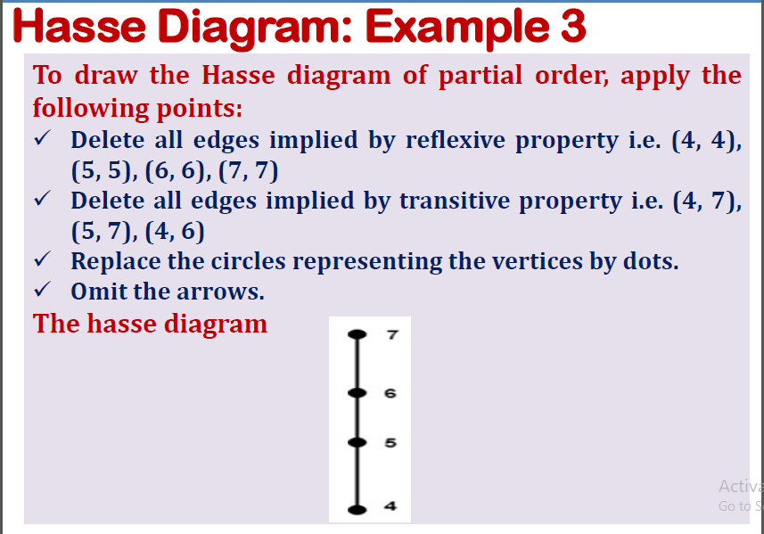

Slide 15
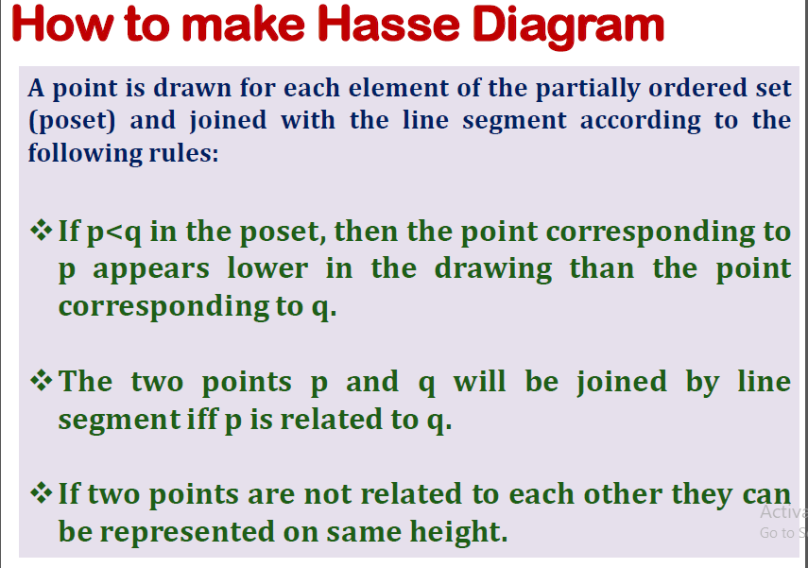

Slide 16
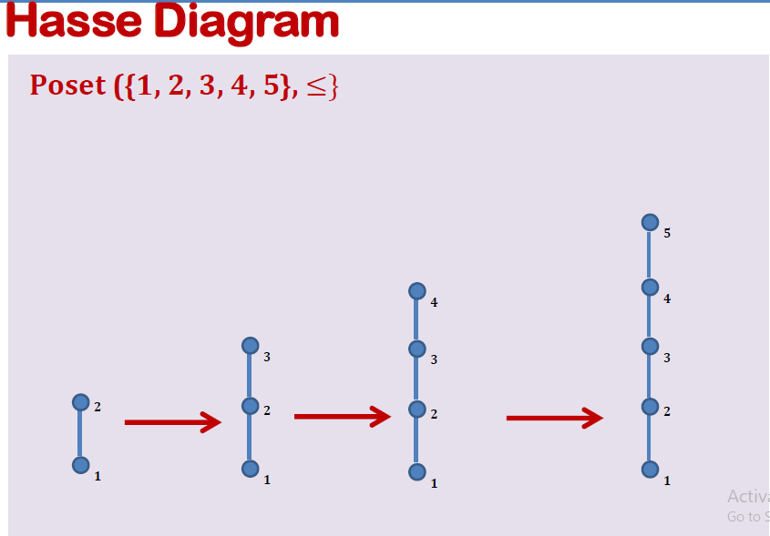

Slide 17
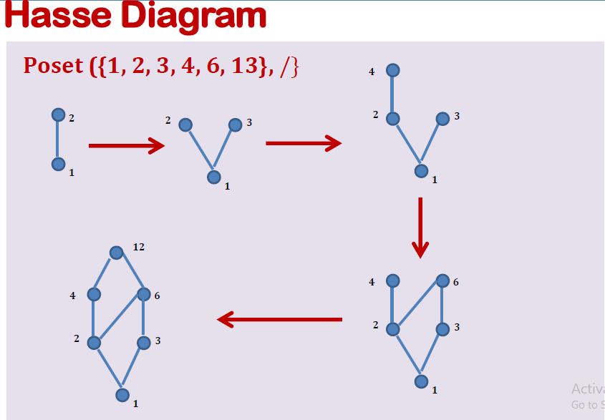

Slide 18
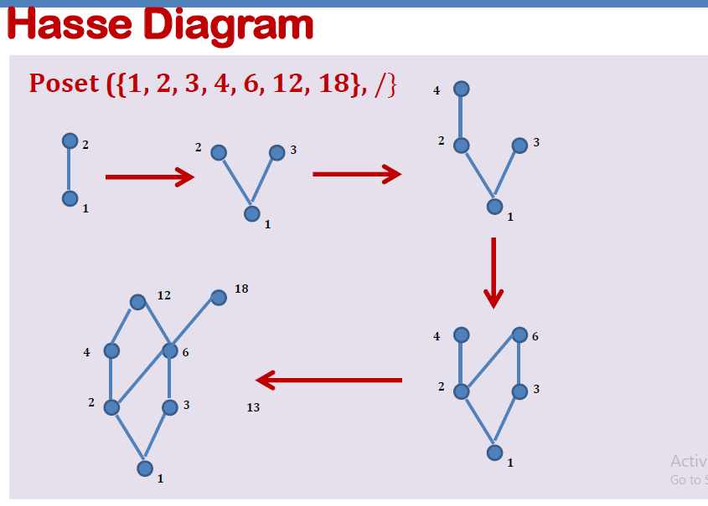

Slide 19
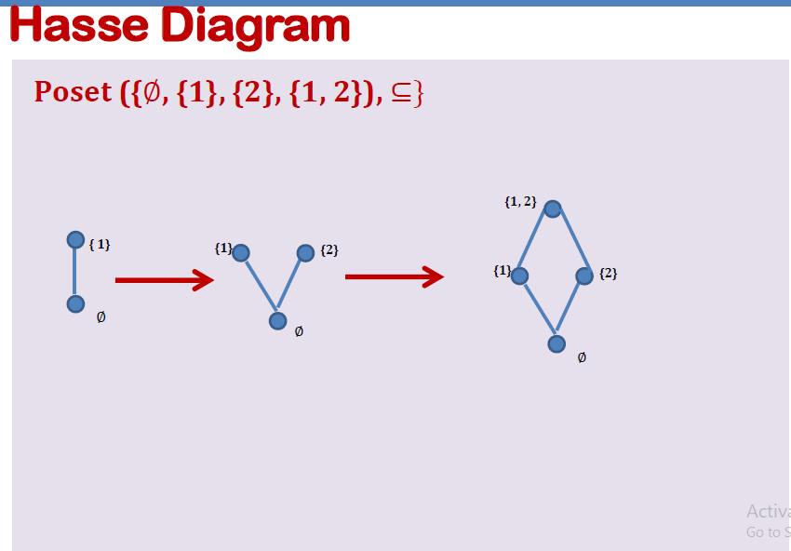

Slide 20
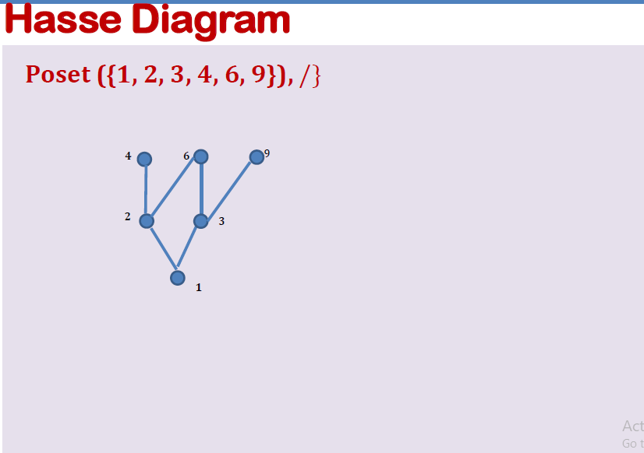

Slide 21
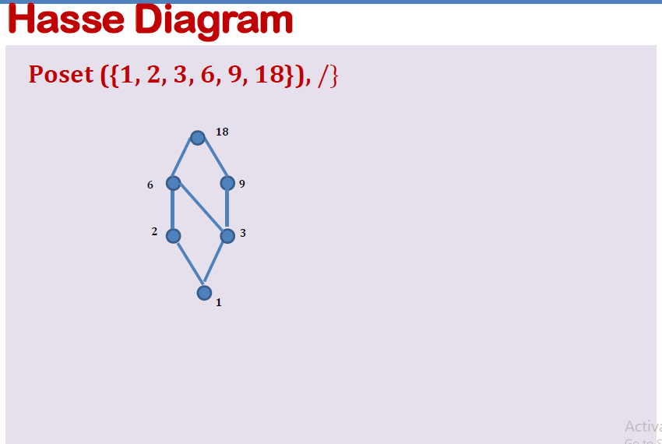

Slide 22
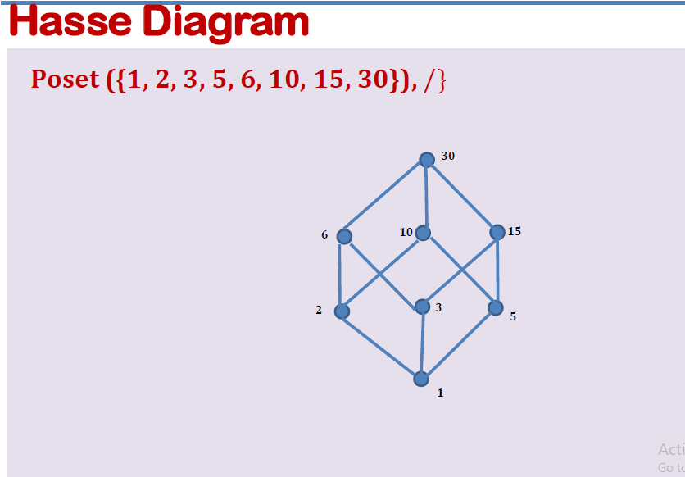

Slide 23
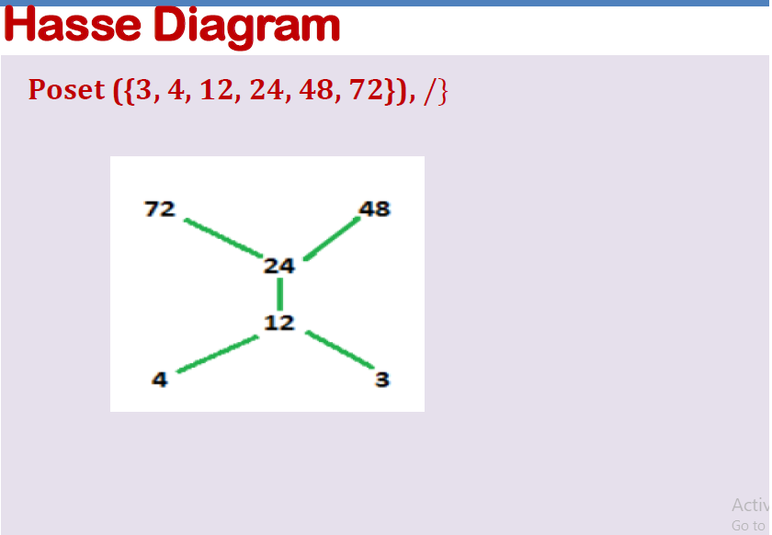

Slide 24
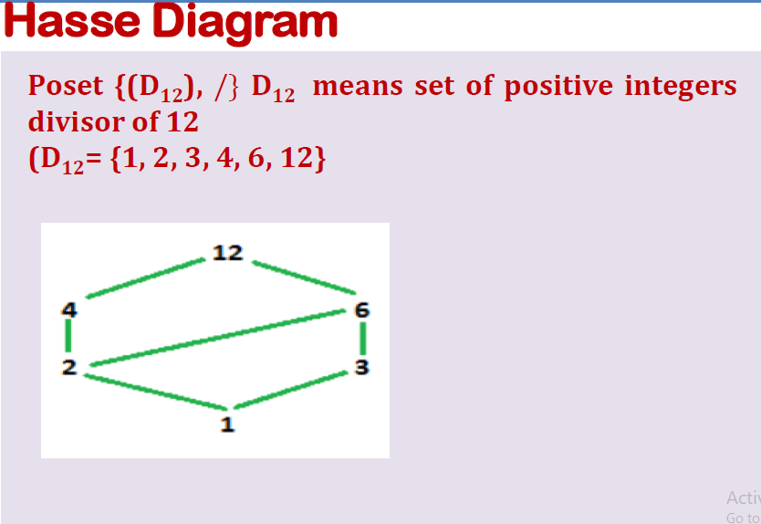

Slide 25
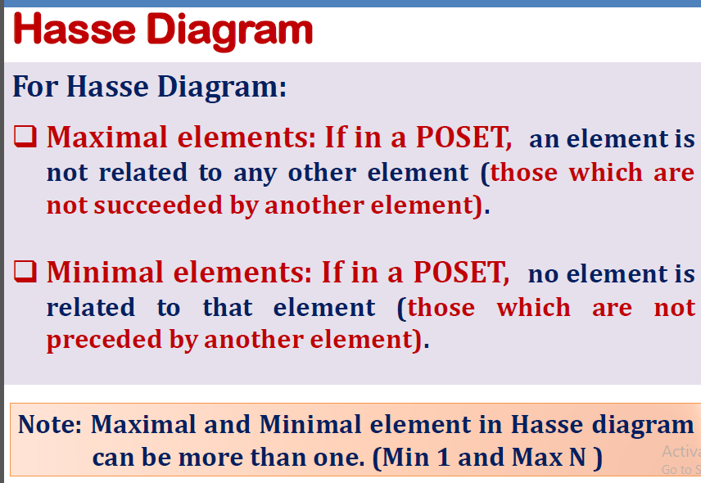

Slide 26
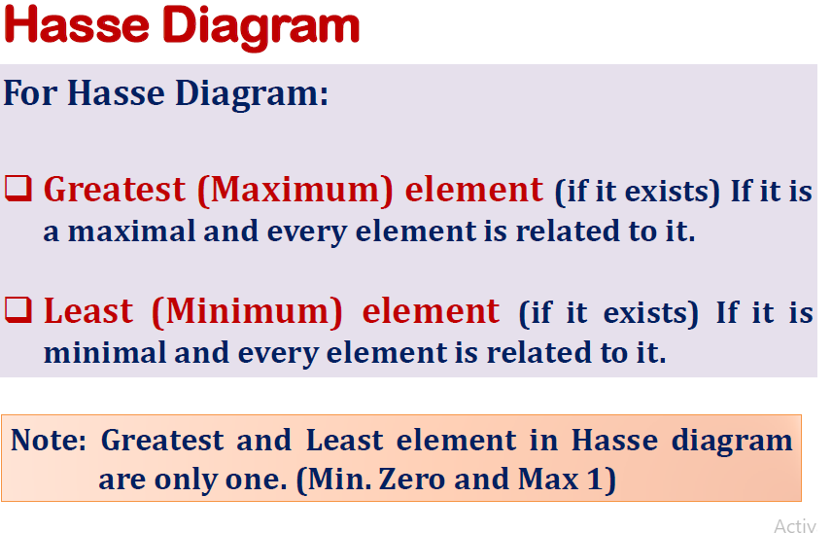

Slide 27
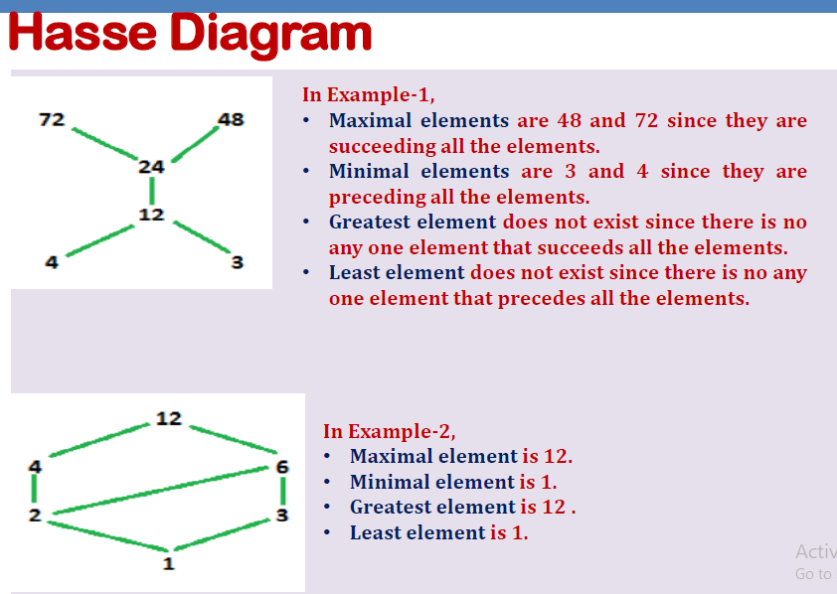

Slide 28
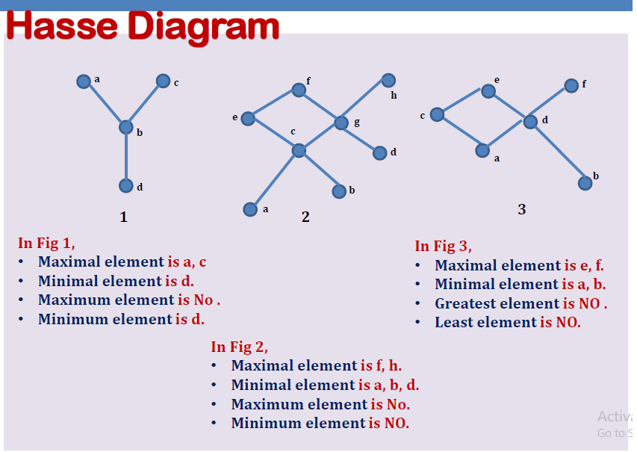

Slide 29
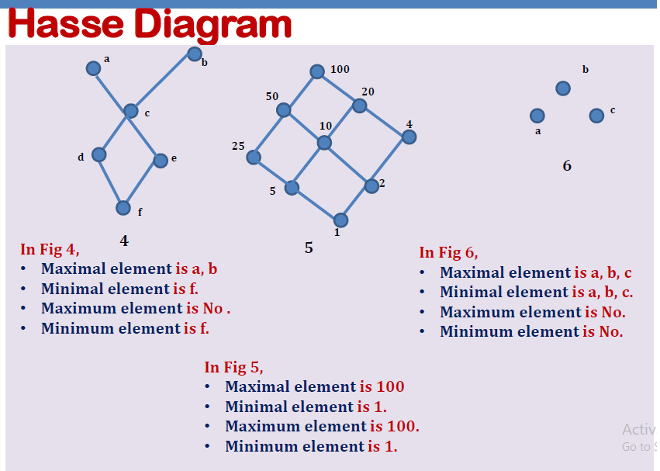

Slide 30
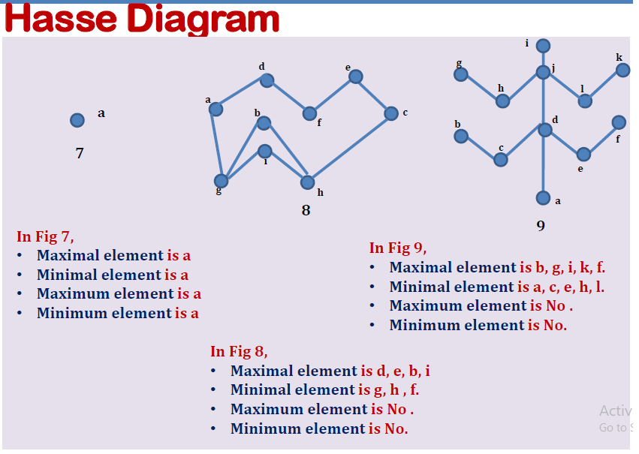

Slide 31
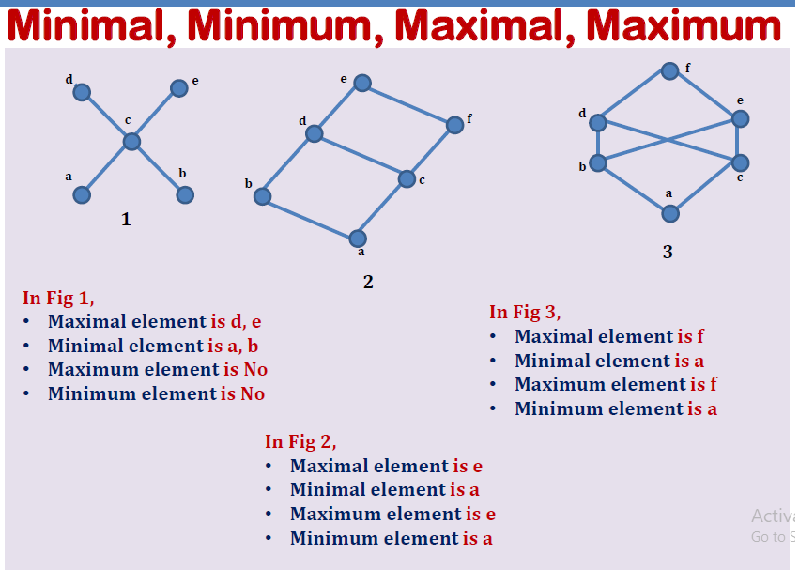

Slide 32
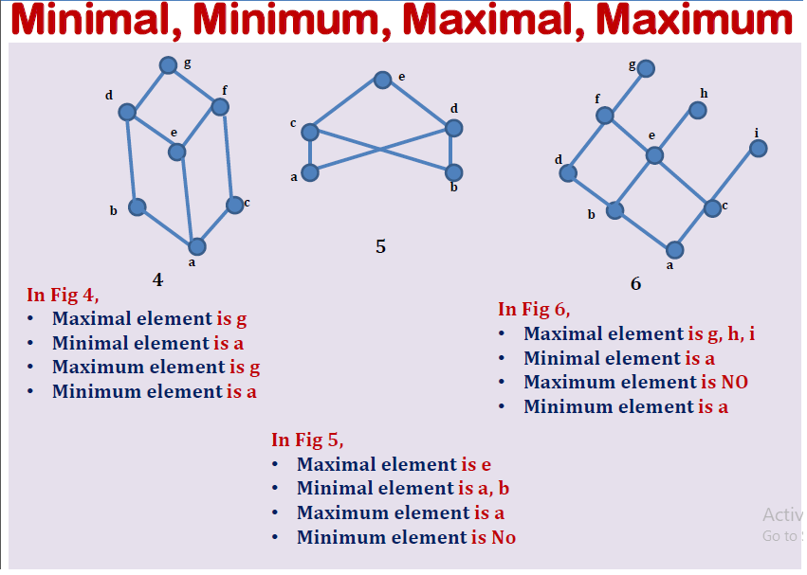

Slide 33
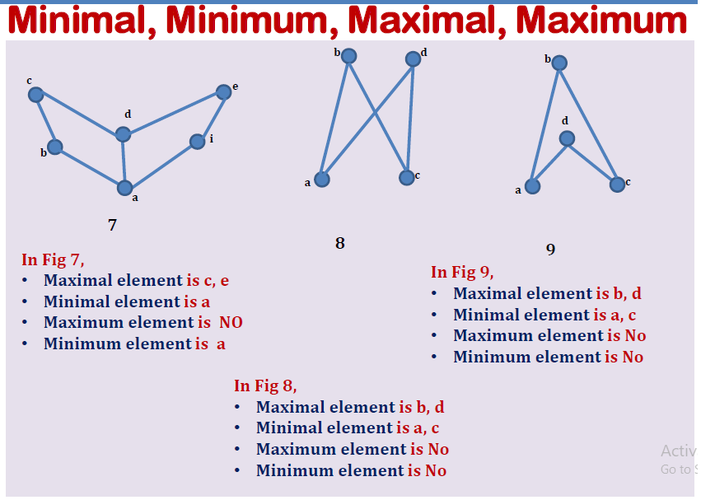

Slide 34
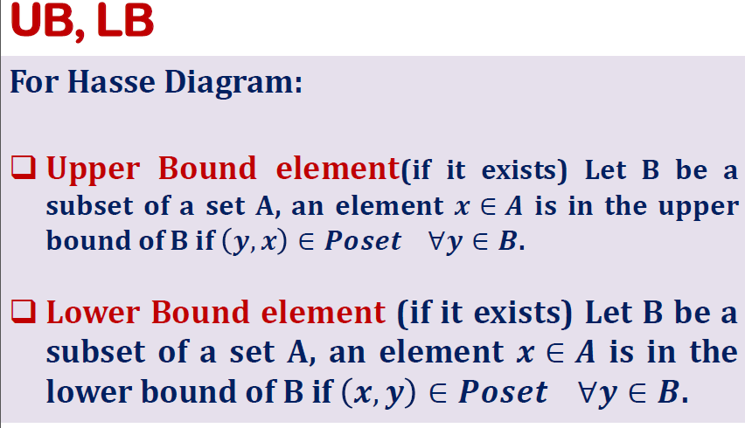

Slide 35
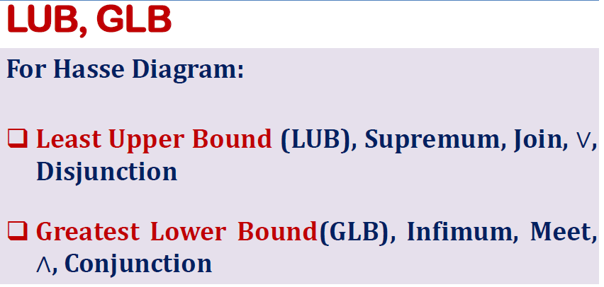

Slide 36
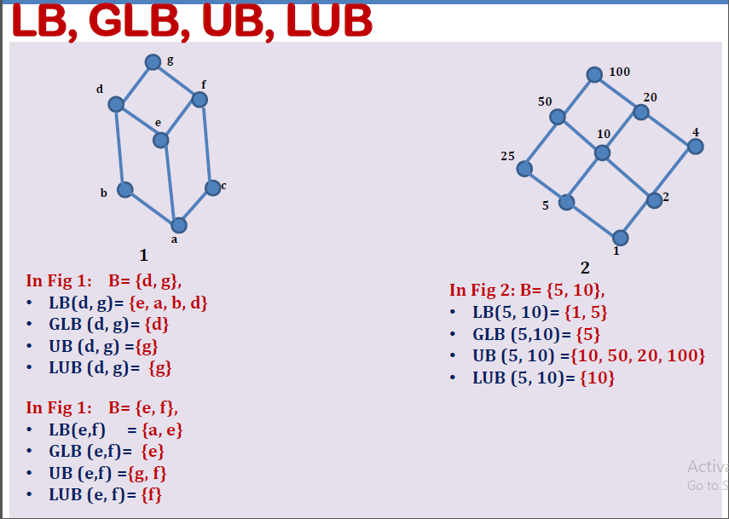

Slide 37
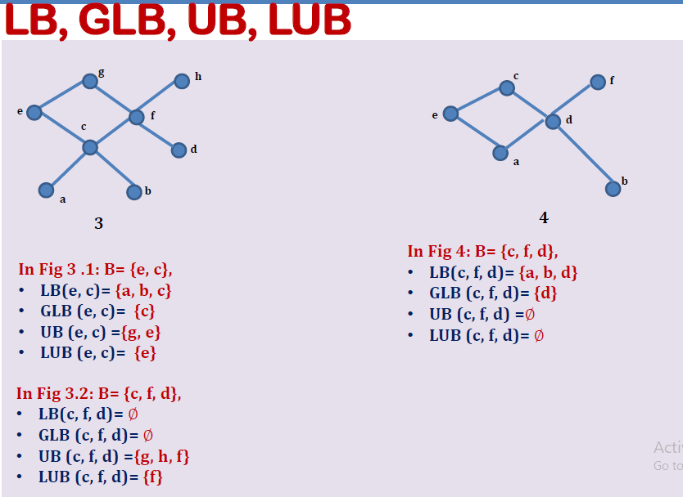

Slide 38
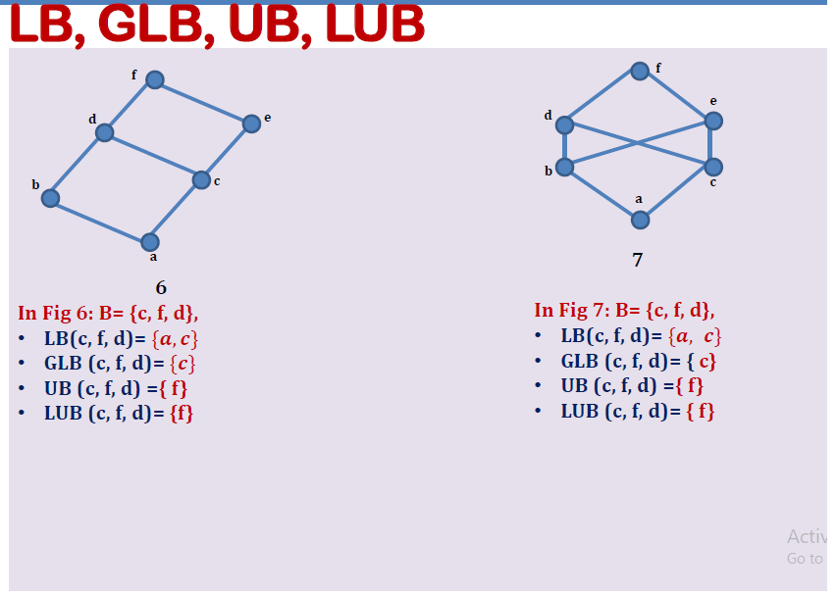

Slide 39
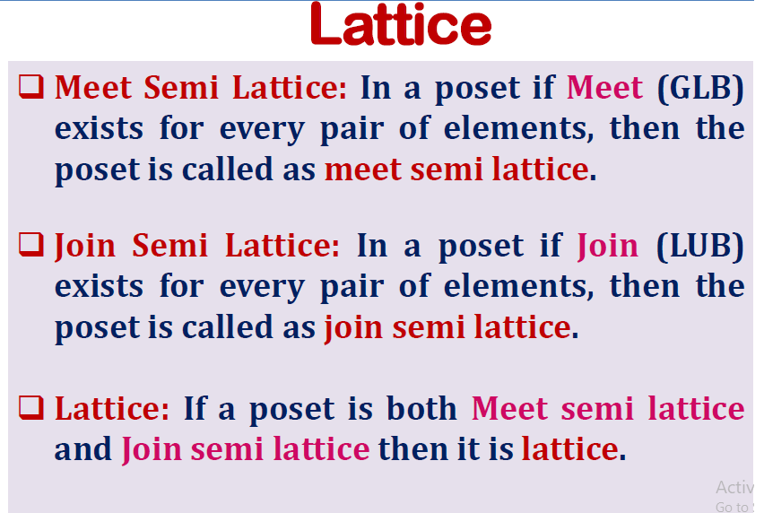

Slide 40
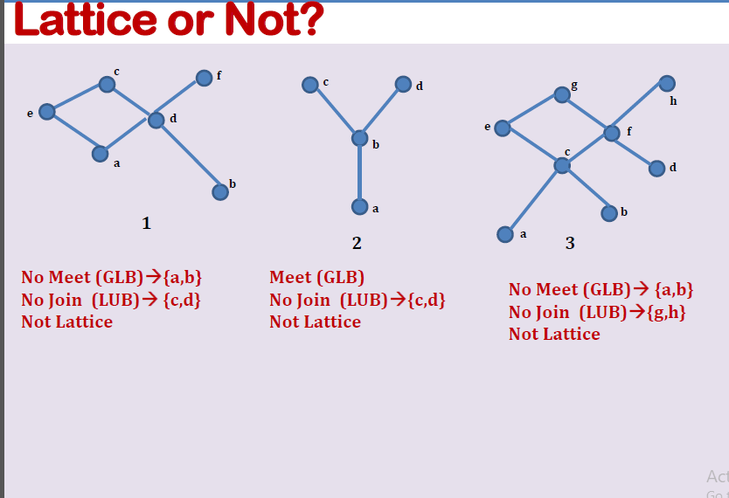

Slide 41
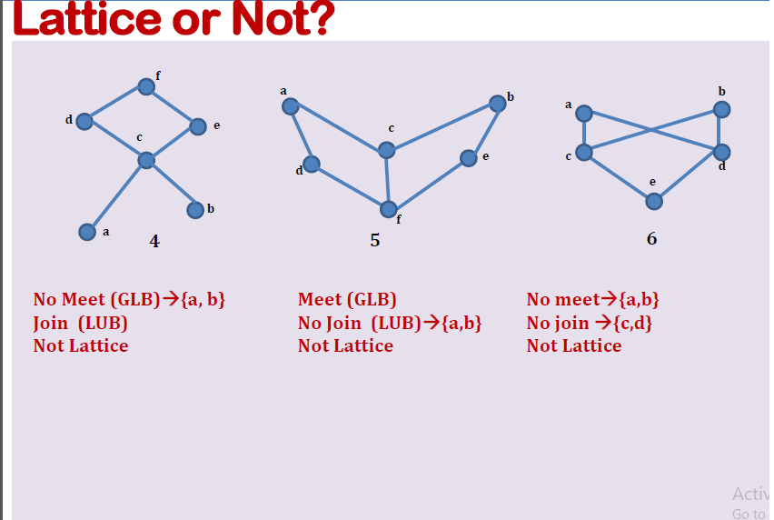

Slide 42
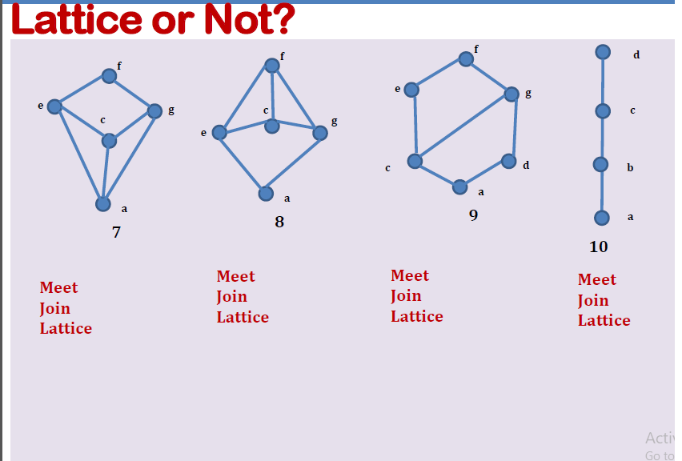

Slide 43
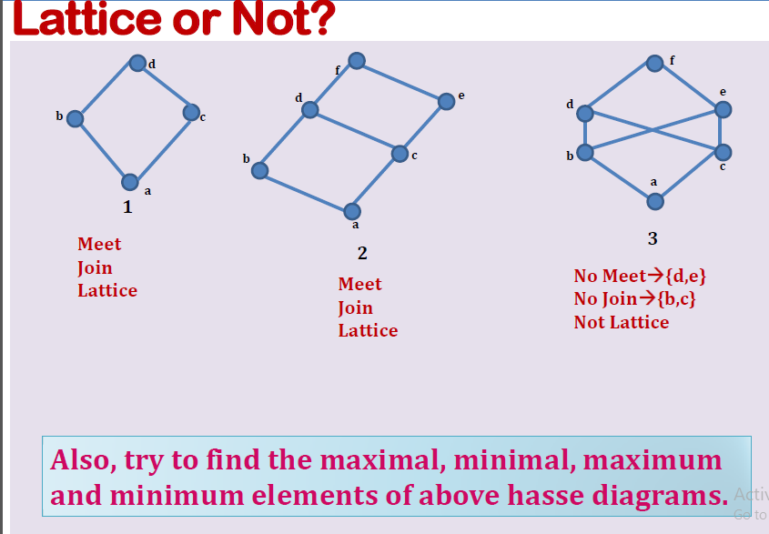

Slide 44
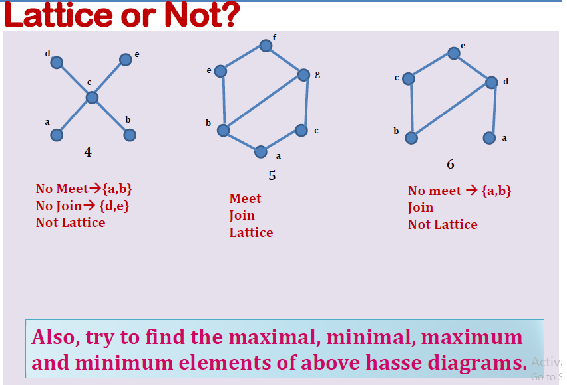

Slide 45
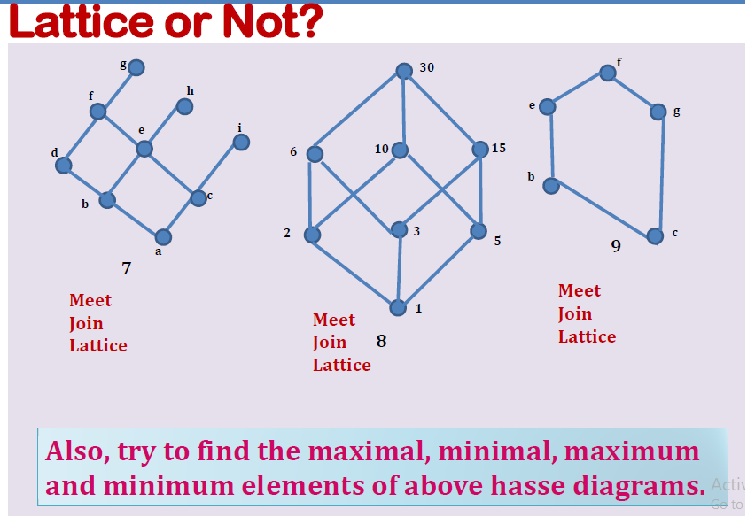

Slide 46
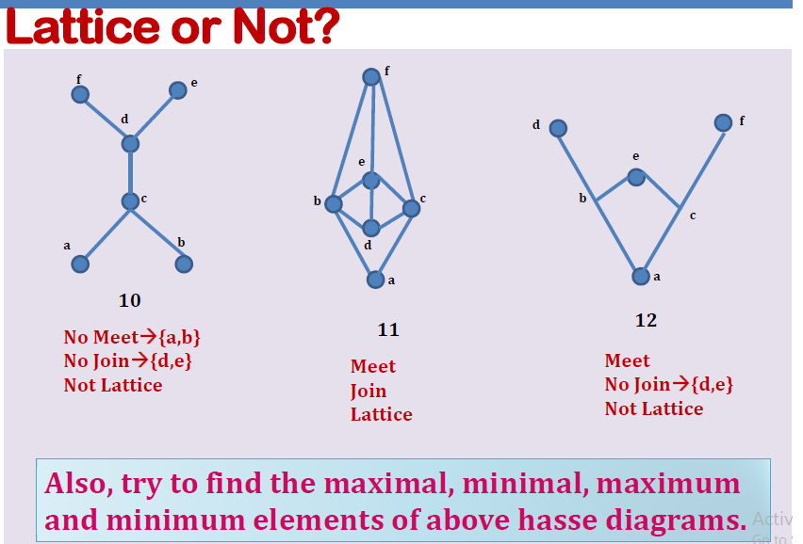

Slide 47
Thank You

